Slide 1
ITCS 6144/8144 Course Project
Understand Linux OS via Dynamic Tracing Tool (Systemtap)
(Midterm Report)
Abdullah Al Raqibul Islam (UNCC ID # 801151189)

Slide 2
Motivation
Finding software bugs due to incorrect system setup
System administrator perform instrumentation in finding those bugs
it could be performance statistics collection and their analysis
debug or system audit
One of the common approaches to instrumentation is “sampling” by installing probes at specified places of software
collect state of the system: values of some variables, stacks of threads, etc.
Sampling is very helpful when you do not know where issue happens
for example, some function, say foo() that processes lists of elements, consumes 80% of the time, but doesn't say why
list is too long
list is inappropriate data structure for foo()
With tracing we can install a probe to that function, gather information on lists (say their length) and collect cumulative execution of function foo(), and then cross-reference them, searching for a pattern in lists whose processing costs too much CPU time.

Slide 3
Platform
Centos 7 on VirtualBox
Kernel: Linux 3.10.0-957.el7.x86-64

Slide 4
Project Overview
Understand and observe the internal behaviors and performance characteristics of Linux operating system
Prepared several systemtap script to understand system-call and process

Slide 5
Work Done till Midterm
To Understand System Calls
Within specific time duration, observe all the system calls issued
by a process
in the whole system
Within specific time duration, trace time spent in all system calls in a per process way
To Understand Processes
Trace parent-child tree of a process
Detailed current process information (including executable files, command line arguments, environment variables, uid, gid, cpuid, etc.)
Trace the time duration a process takes before the process actually starts to execute.

Slide 6
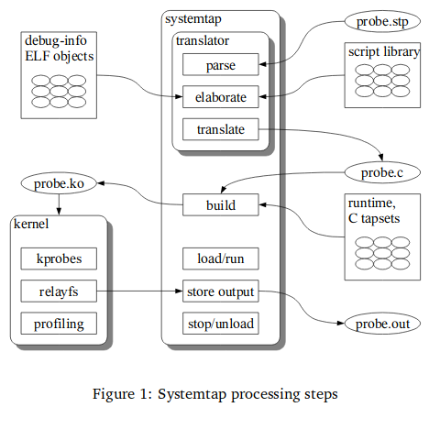
Systemtap Processing Steps

Slide 7
Operating system kernel tracing (Understand System Calls)
Prepared several scripts to collect system-call statistics w.r.t whole system or specific process
syscall_count.stp: collect system-call data for the whole system, show the top 20 <process, syscall> pair in every 10 seconds
syscall_count_arg.stp: collect system-call data for the process passed by argument, show the top 20 syscalls by the corresponding process in every 10 seconds
syscall_timetrace_by_proc.stp: trace time spent in all system calls in a per-process way, show the top 20 results in every 10 seconds.

Slide 8
Operating system kernel tracing (Understand System Calls)
[raqib@localhost systemcall]$ sudo stap syscall_count_arg.stp gnome-shell Collecting system-call data for the process: gnome-shell Top 20 syscall by process [gnome-shell] will be displayed for the interval of 10 seconds Type Ctrl+c to exit the program Process Name Syscall Name #Syscalls gnome-shell recvmsg 560 gnome-shell poll 224 gnome-shell writev 112 gnome-shell write 16 gnome-shell read 16 ***************<>*************** Process Name Syscall Name #Syscalls gnome-shell recvmsg 693 gnome-shell poll 274 gnome-shell writev 137 gnome-shell write 25 gnome-shell read 21 ***************<>*************** Total Syscall Result for Process [gnome-shell]: Process Name Syscall Name #Syscalls gnome-shell recvmsg 1526 gnome-shell poll 600 gnome-shell writev 299 gnome-shell write 59 gnome-shell read 47

Slide 9
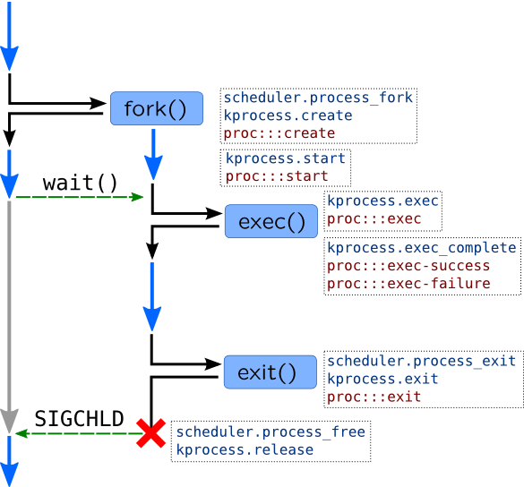
Operating system kernel tracing (Understand Process)
Lifetime of a process and corresponding probes are shown here ->
Unix process is started by a two stage way,
Parent process calls fork() system call
Kernel creates exact copy of a parent process including address space
If fork() is successful, it will return in the context of two processes (parent and child).
Child process calls execve() system call
to replace address space of a process with a new one based on binary which is passed to execve() call
In completion of a process,
When child process finishes its job, it will call exit() system call.
If parent wants to wait until child process finishes, it will call wait() system call, which will stop parent from executing until child exits.

Slide 10
Operating system kernel tracing (Understand Process)
Processes may be traced with kprocess and scheduler tapsets in SystemTap. Here are some useful probes:
Action | SystemTap Probes
Process creation | kprocess.create scheduler.process_fork
Forked process begins its execution | kprocess.start: called in a new process context Scheduler.wakeup_new: process has been dispatched onto CPU first time
execve() | Kprocess.exec: entering execve() Kprocess.exec_complete: execve() has been completed, success variable has true-value if completed successfully, errno variable has error number in case of error
Process finished | kprocess.exit scheduler.process_exit
Process structures deallocated due to wait()/SIGCHLD | kprocess.release scheduler.process_free

Slide 11
Operating system kernel tracing (Understand Process)
2029[ bash]/ 5394[gnome-terminal-] kprocess.create
2029[ bash]/ 5394[gnome-terminal-] scheduler.process_fork
Parent ID: [2029] -> Child ID: [2053]
2029[ bash]/ 5394[gnome-terminal-] scheduler.wakeup_new
process_id [2029] took 221233 microseconds to be dispatched onto CPU first time
2053[ bash]/ 2029[ bash] kprocess.start
2053[ bash]/ 2029[ bash] kprocess.create
2053[ bash]/ 2029[ bash] scheduler.process_fork
Parent ID: [2053] -> Child ID: [2054]
2053[ bash]/ 2029[ bash] scheduler.wakeup_new
process_id [2053] took 421 microseconds to be dispatched onto CPU first time
2053[ bash]/ 2029[ bash] syscall.wait4
2053[ bash]/ 2029[ bash] scheduler.process_wait
2054[ bash]/ 2053[ bash] kprocess.start
2054[ bash]/ 2053[ bash] syscall.execve
2054[ bash]/ 2053[ bash] kprocess.exec
filename: "/usr/bin/uname"
2054[ uname]/ 2053[ bash] kprocess.exec_complete
2054[ uname]/ 2053[ bash] kprocess.exit
return code: 0
2054[ uname]/ 2053[ bash] scheduler.process_exit
2053[ bash]/ 2029[ bash] kprocess.release

Slide 12
Reference
Dynamic Tracing with DTrace & SystemTap: https://myaut.github.io/dtrace-stap-book/
Architecture of systemtap:a Linux trace/probe tool: https://sourceware.org/systemtap/archpaper.pdf
SystemTap Beginners Guide: https://lrita.github.io/images/posts/systemtap/SystemTap_Beginners_Guide.pdf
SystemTap Tapset Reference Manual: https://sourceware.org/systemtap/tapsets/

Slide 13
Thank you

